Slide 1



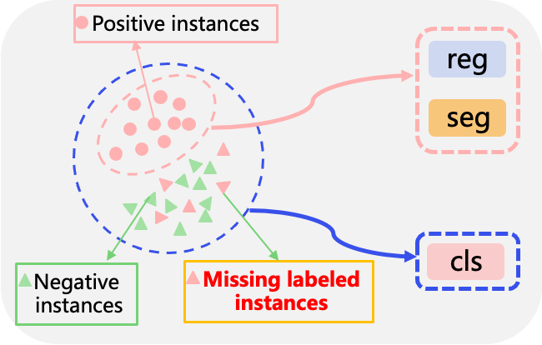
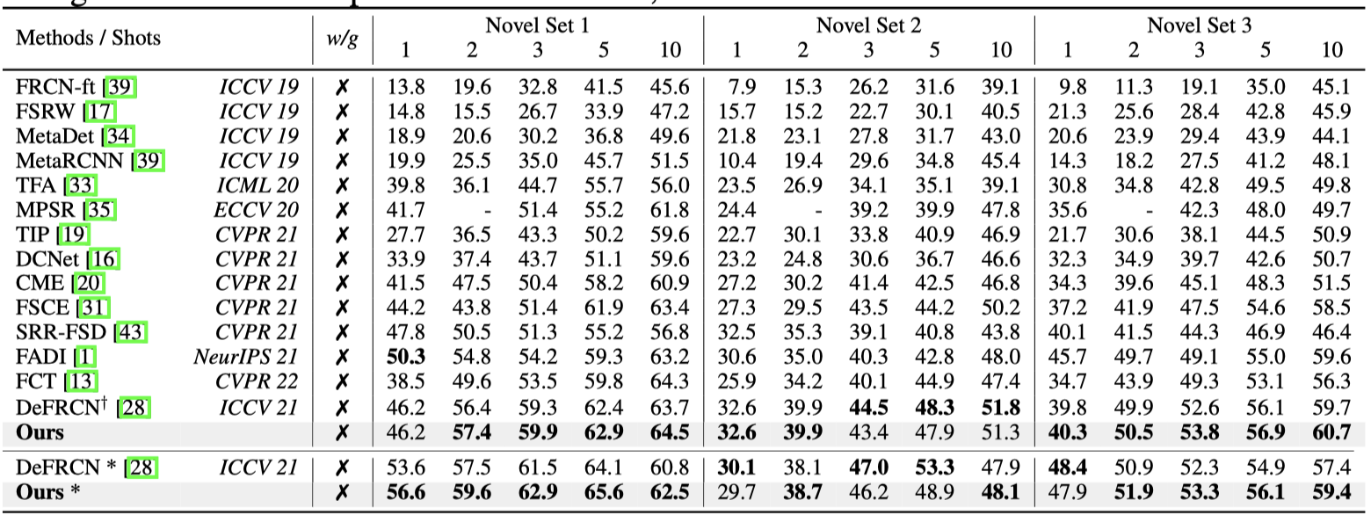
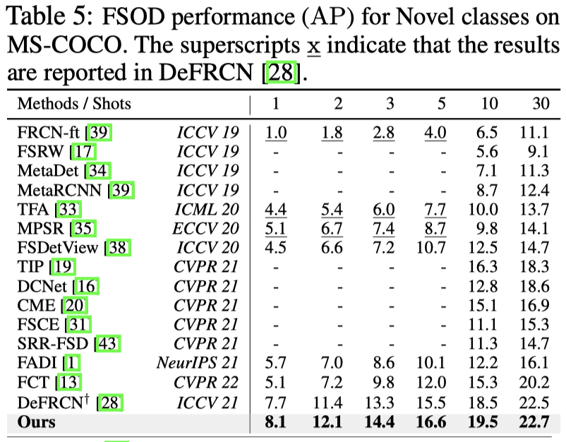



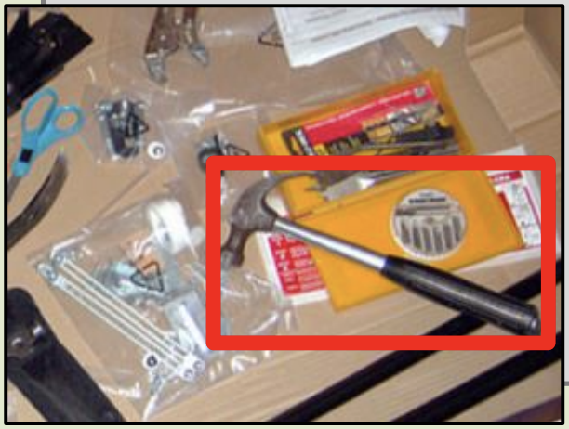
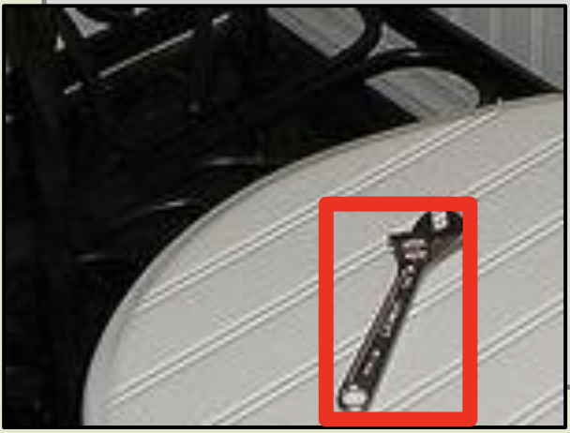
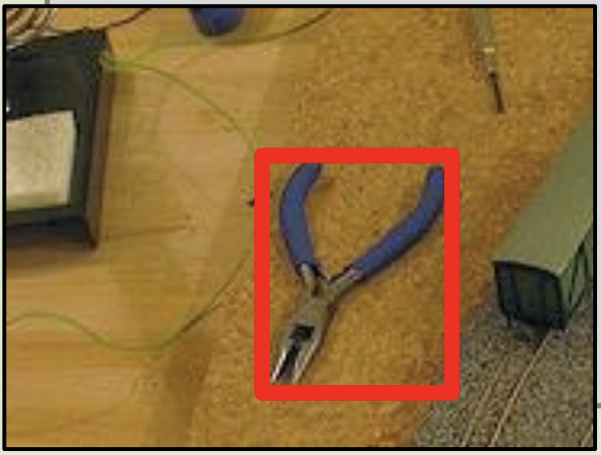
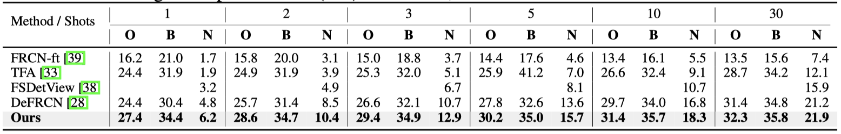
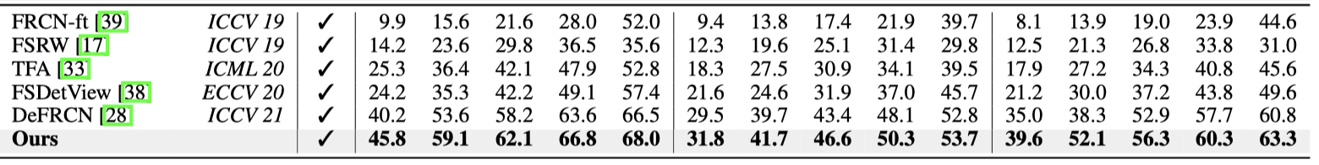
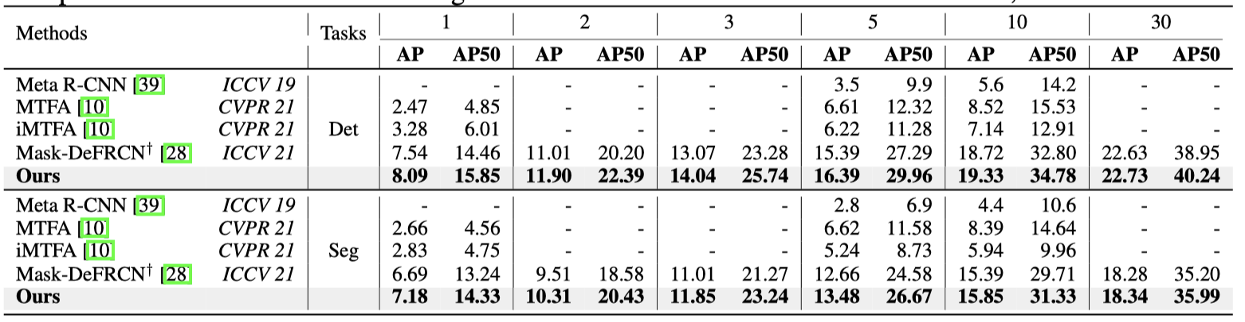

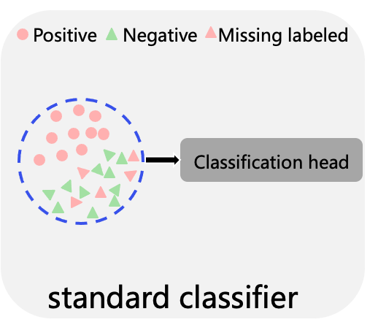
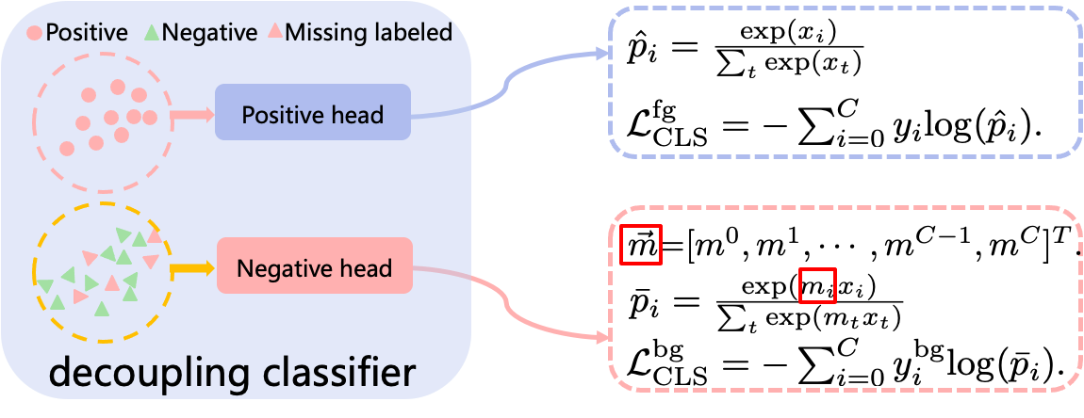
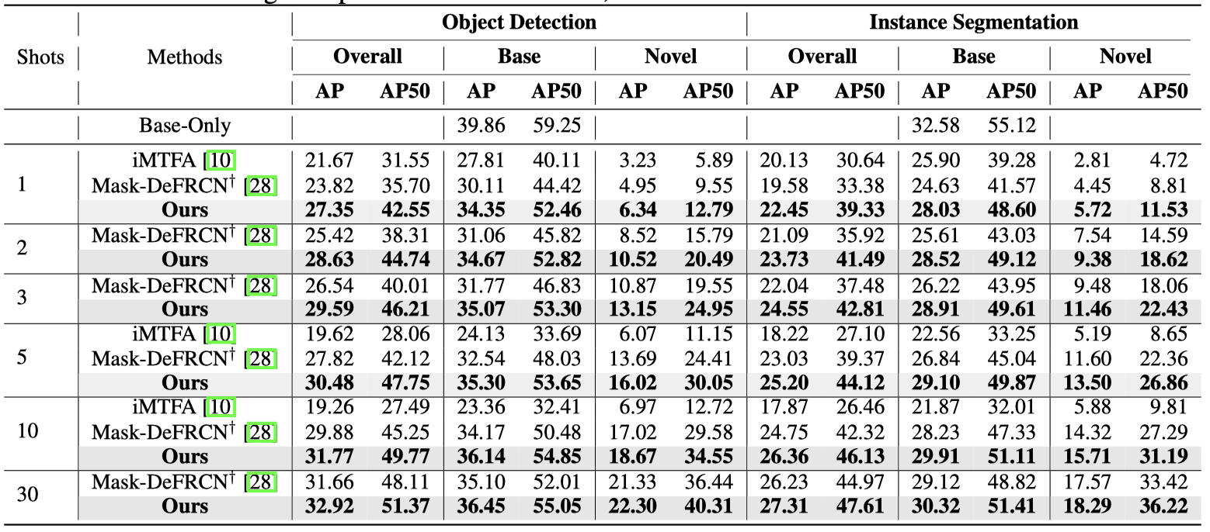

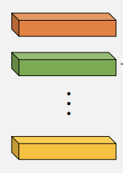
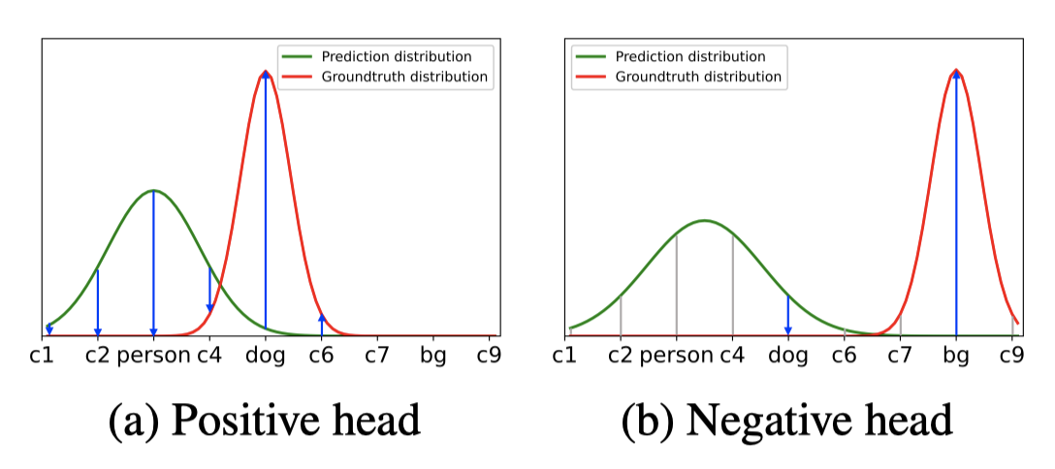
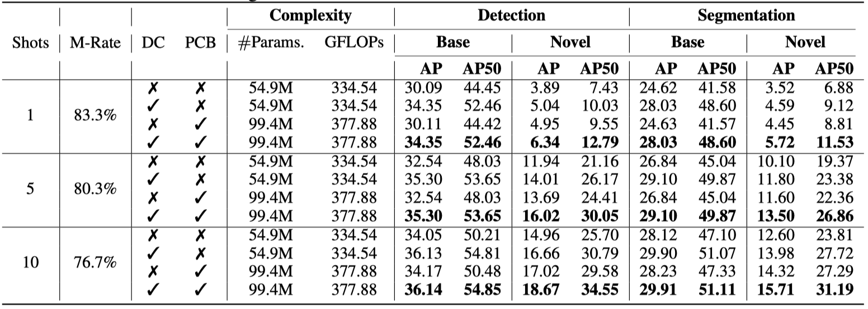
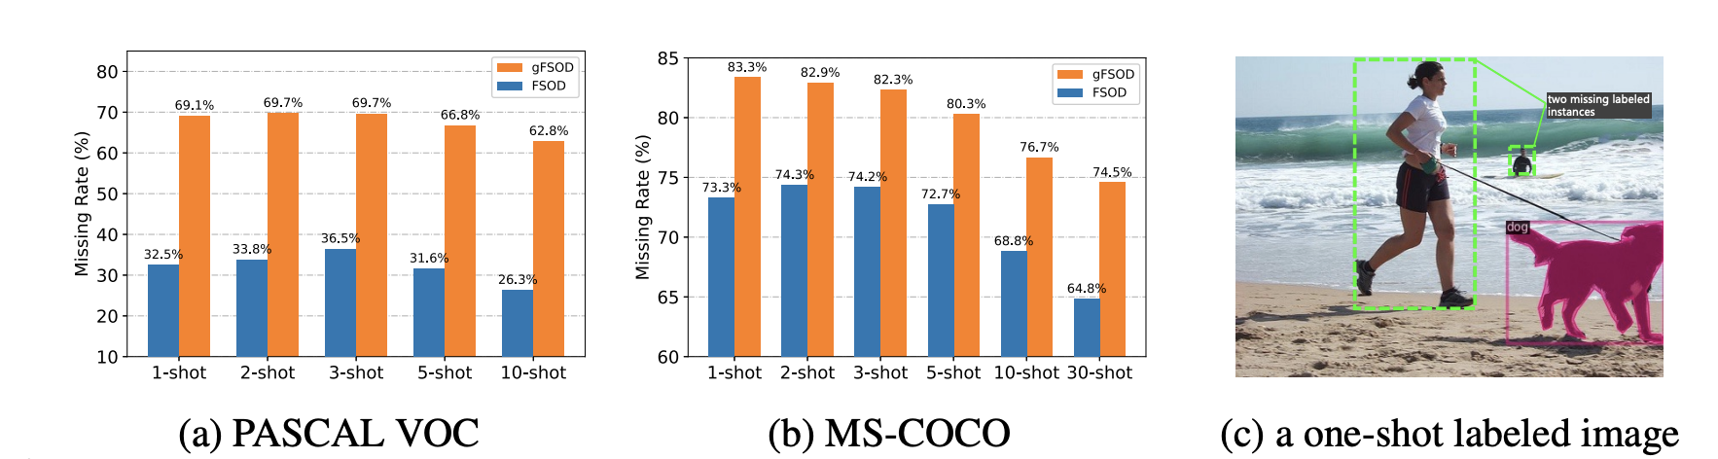
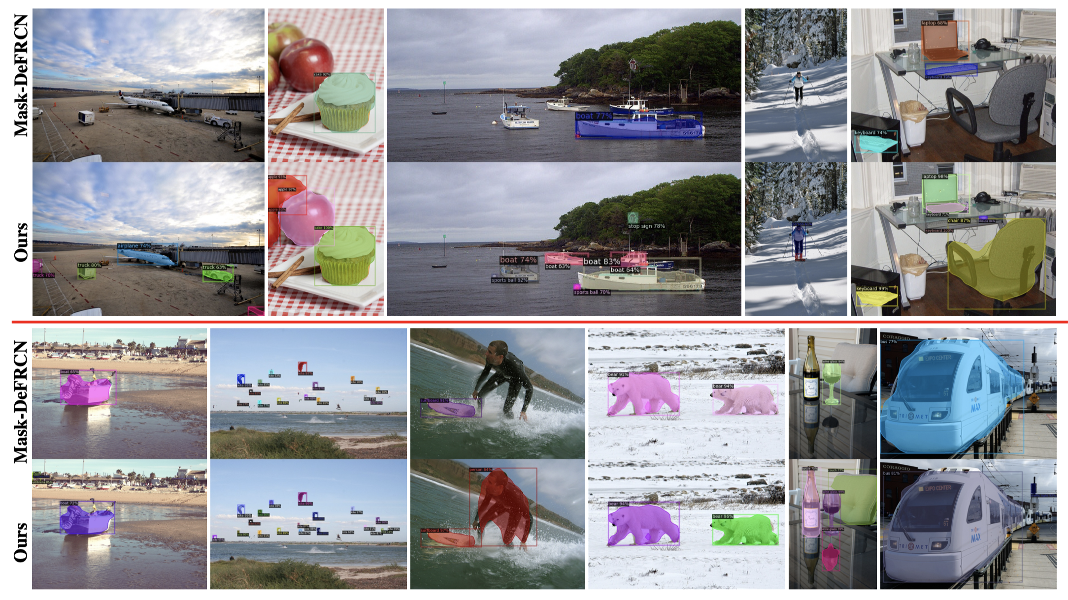
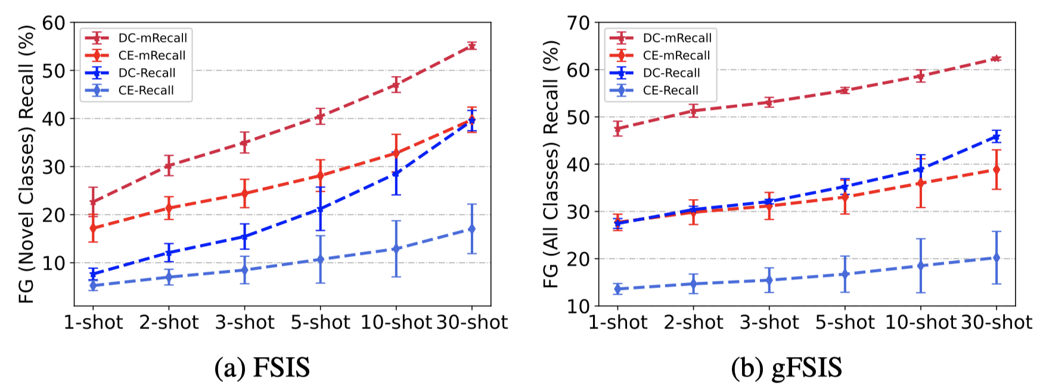
Decoupling Classifier for Boosting Few-shot Object Detection and Instance Segmentation
Bin-Bin Gao¹, Xiaochen Chen¹, Zhongyi Huang¹, Congchong Nie¹, Jun Liu¹
Jinxiang Lai¹, Guannan Jiang², Xi Wang² and Chengjie Wang¹
1. Introduction
3. Our Method: Decoupling Classifier
4. Experiments
Few-shot object detection (FSOD) and instance segmentation (FSIS) ﻿aims to detect and segment novel objects with very few labeled instances.
3.1 Revisiting object detection and instance segmentation
4.1 Comparisons with the state-of-the-art FSOD on PASCAL VOC and MS-COCO
Abundant labeled instances for base classes
The box regression and mask segmentation head can be well learned with clear positive instances.
However, the classification head may be confused by missing labeled instances and thus results in a biased classification towards incorrectly recognizing foreground objects as background.
Table 1: FSOD comparisons on PASCAL-VOC. Table 2: FSOD comparisons on MS-COCO.
base training
stage
Person, Dog Car Bird
FSOD and FSIS
Vey Few labeled instances for novel classes
Table 3: gFSOD comparisons on PASCAL-VOC. Table 4: gFSOD comparisons on MS-COCO.
novel training
stage
Hammer Wrench Pliers
3.2 Decoupling Classifier
4.2 Comparisons with the state-of-the-art FSIS on MS-COCO
2. Motivation
We propose a simple but effective method that decouples the standard classifier into two parallel heads to independently process clear positive instances and negative ones with missing labels.
Table 5: FSIS comparisons on MS-COCO.
2.1 Meta-learning paradigm
2.2 Transfer-learning paradigm
FSOD and gFSOD:
outperform SOTA methods by a large margin with gFSOD setting;
better than SOTA under most cases with FSOD setting.
FSIS and gFSIS:
achieve SOTA results both FSIS and gFSIS.
Query
RPN
RoI Align
Support
Backbone
cls
Table 6: gFSIS comparisons on MS-COCO.
shared
reg
Backbone
Global AvgPool
seg
Section header in 34pt font
complicated training process (episodic training) and data organization (support-query pair).
Optional section descriptor in 21pt font
Base training
Novel Fine-tuning
3.3 Discussion (why does the decoupling classifier work well?)
4.3 Ablation study
RPN
cls
Gradient optimization:
Positive head:
Table 7: The effects of DC and PCB for FSIS performance on MS-COCO.
Effectiveness:
It is effective not only on novel classes but also on base classes;
Efficiency:
no any additional parameters or computation costs.
Backbone
RoI Align
reg
seg
more simple and efficient.
Negative head:
2.3 Missing label issue in FSOD and FSIS
4.4 Qualitative Evaluation
5. Conclusions
rethink FSOD and FSIS from label completeness perspective;
propose a simple but effective method for FSOD and FSIS;
achieve the state-of-the-art results both FSOD/FSIS and gFSOD/gFSIS setting.
Generalization ability:
measuring with Recall and mRecall of all foreground instances on testing images.
The Recall & mRecall values of decoupling classifier are higher that of standard one on each shot for both FSIS and gFSIS. This means that our decoupling classifier is helpful to mitigate biased classification.
Instance-level FSOD and FSIS considering an instance as a shot for each class which meets missing label issue. Furthermore, this will limit generalization ability of few-shot model on novel classes.
The missing label learning is related to partial or incomplete label learning, which is more difficult and challenging, especially instance-level few-shot scenarios.

